Slide 1
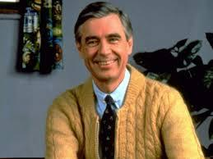
Know Thy Neighbor: An Introduction to Scikit-Learn and K-NN
Portia Burton
PLB Analytics
www.github.com/pkafei

Slide 2
About Me:
Organizer of the Portland Data Science group
Volunteer of HackOregon
Founder of PLB Analytics

Slide 3
What We will Cover Today
1. Brief Intro to Machine Learning
2. Go Over Scikit-learn
3. Explain the k-Nearest Neighbor algorithm
4. Demo of Scikit-learn and kNN
5. Explore the sample script
6. The next step

Slide 4
Machine Learning

Slide 5

Machine Learning
The algorithm learns from the data

Slide 6
What is Machine Learning
Algorithms use data to….
Create predictive models
Classify unknown entities
Discover patterns
Notes:
http://www.wired.com/insights/2014/03/use-data-tell-future-understanding-machine-learning/

Slide 7
Basic Workflow of Machine Learning

Slide 8
70%
Preprocess, Training, Validate
10%
Analyze and Visualize
Clean and Standardize Data
20%

Slide 9

Scikit-Learn

Slide 10
What is scikit-learn?
Python machine learning package
Great documentation
Has built in datasets(i.e. Boston housing market)

Slide 11
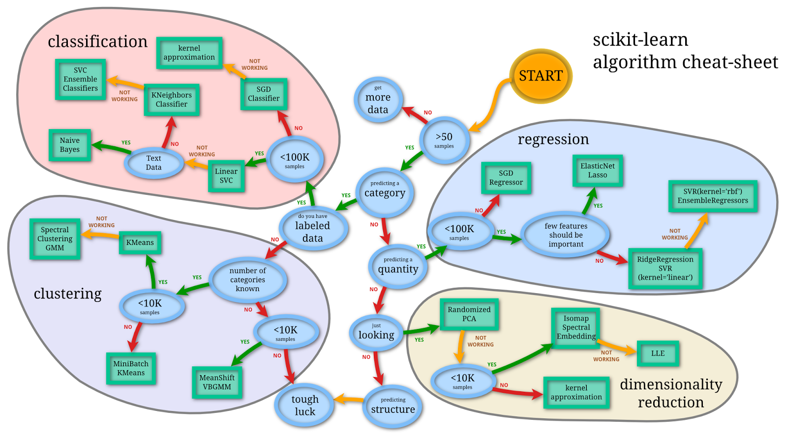
**
Notes:
http://peekaboo-vision.blogspot.com/2013/01/machine-learning-cheat-sheet-for-scikit.html
**linear regression
*regression can be used with categorical data and for dimensionality reduction
A regression is using a set of inputs to predict a set of outputs (blood pressure, weight, bmi, cholestrol to predict heart attack risk)
Dimensionality reduction (farmer wants to know why corn grow)

Slide 12
Many companies use Scikit-Learn

Slide 13

Notes:
Is an app that helps you organize your notes into notebooks

Slide 14
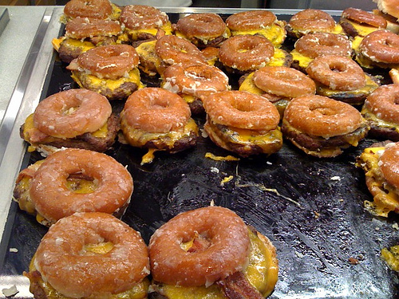
Are You a Recipe? Yum.
Distinguishes ‘recipe’ notes from ‘work’ notes
Suggesting notebooks is a classification problem
Implements naïve bayes classification algorithm
Notes:
http://blog.evernote.com/tech/2013/01/22/stay-classified/

Slide 15
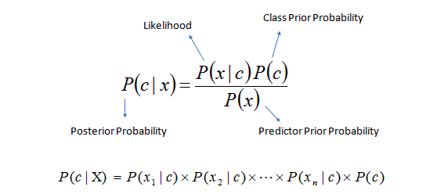
Naïve Bayes Classification
“naive” assumption of independence between every pair of features
Notes:
NaiveBayes, the concept of 'probability' is used to classify new entities

Slide 16
Supervised vs. Unsupervised Learning

Slide 17
Unsupervised Learning
Data points are not labeled with outcomes. Patterns are found by the algorithm.

Slide 18
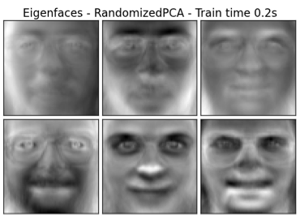
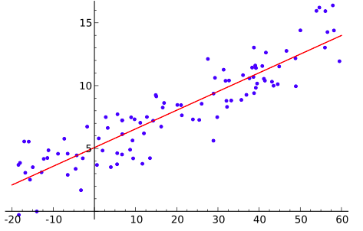
Supervised Learning
When your samples are labeled

Slide 19
Theoretical Data Model for Supervised Learning
Outcome
Predictor #1
Predictor #2
Predictor #3
Observations

Slide 20
Remember to…
Keep your sample size high

Slide 21
And don’t forget to
Keep your feature set low
Notes:
Reduce dimensionality and prevent overfitting

Slide 22
Examples of Supervised Learning

Slide 23

Handwriting Analysis

Slide 24

Spam Filters

Slide 25
k-NN
k Nearest Neighbor algorithm
The simplest machine learning algorithm
It is a lazy algorithm : doesn’t run computations on the dataset until you give it a new data point you are trying to test
Our example uses k-NN for supervised learning

Slide 26
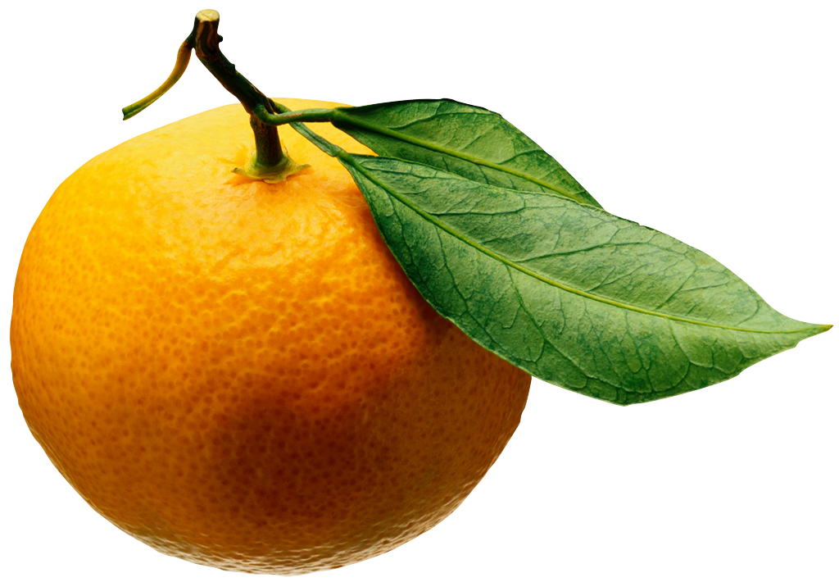
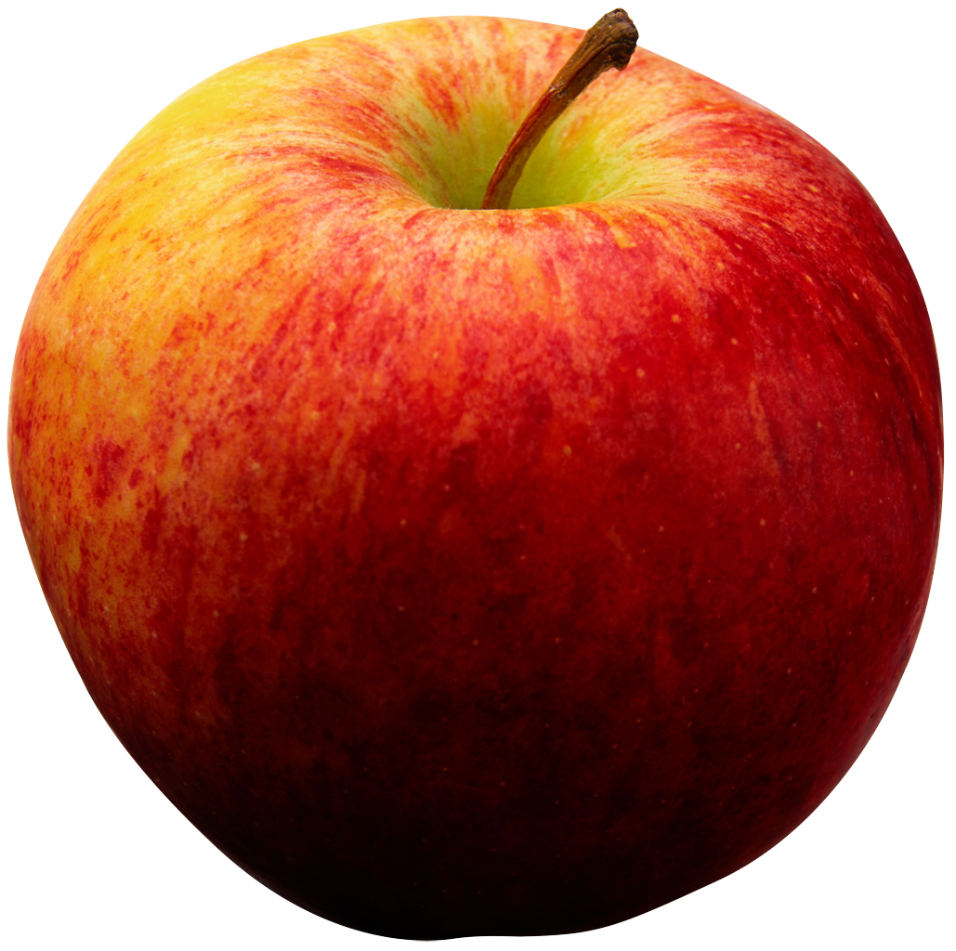
Mystery Fruit
?
Notes:
The basic distance formula
majority vote
uniform not factoring the distance between training point and test point

Slide 27
Majority Vote
Equal weight: Each kNN neighbor has equal weight
Distance weight: Each kNN neighbor’s vote is based on the distance

Slide 28
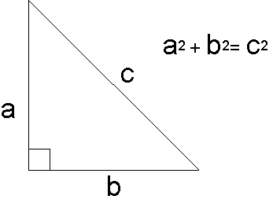
How k-NN works
Notes:
Works with more than just 2 variables (a and b here) can use hundreds, for instance.
The distance formula is used to find out what the k-NN are? Euclidian distance
Pythagorean Theorem

Slide 29
Downsides of kNN
Since there is minimum training there is a high computational cost in testing new data
Correlation is falsely high (data points can be given too much weight)
Notes:
http://saravananthirumuruganathan.wordpress.com/2010/05/17/a-detailed-introduction-to-k-nearest-neighbor-knn-algorithm/
http://mathbabe.org/2013/04/04/k-nearest-neighbors-dangerously-simple/
Cost is number of CPU cycles

Slide 30
Live demo time!

Slide 31
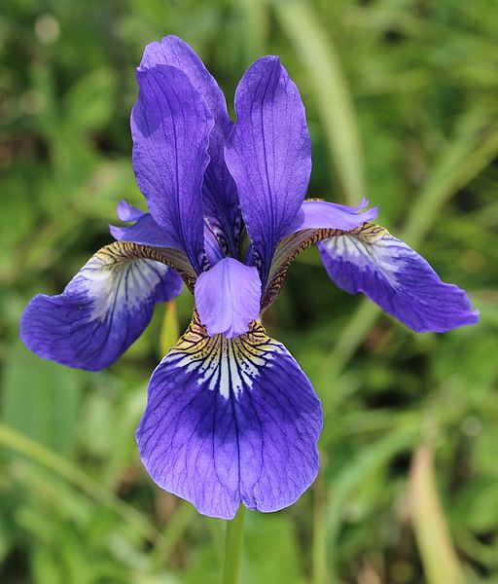
Our Data Set:
Typical!
Multivariate data set was created in 1936
Analyzed by Sir Ronald Fischer
Collected by Edgar Anderson

Slide 32
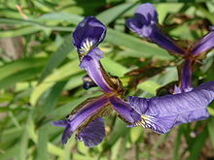
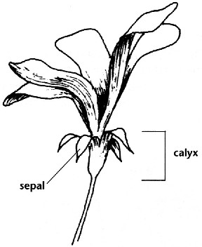
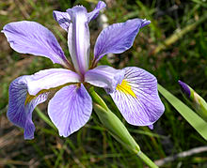
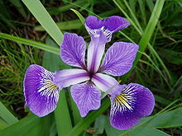
Live coding demo: the data set
Iris setosa
Iris virginica
Petal
Iris versicolor
Notes:
Using measurements of the sepal to classify the Irises

Slide 33
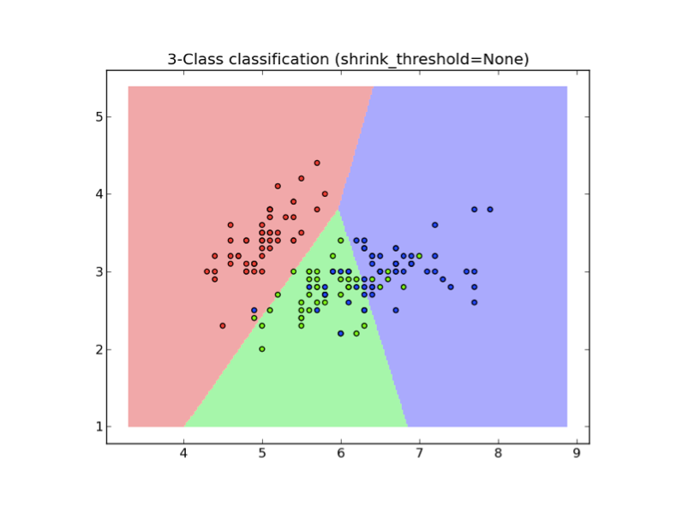
The plot from the use case
Training Data
Test Data
Sepal Width (cm)
Sepal Length (cm)
Notes:
Mesh = grid
Fischer’s Iris data set 1936
http://en.wikipedia.org/wiki/Iris_flower_data_set
[] index, slice notation

Slide 34
Example data points for each iris species
Sepal length (x-axis) | Sepal width (y-axis) | Species
5.1 | 3.5 | I. setosa
5.5 | 2.3 | I. versicolor
6.7 | 2.5 | I. virginica

Slide 35
References:
http://www.solver.com/xlminer/help/k-nearest-neighbors-prediction-example
http://saravananthirumuruganathan.wordpress.com/2010/05/17/a-detailed-introduction-to-k-nearest-neighbor-knn-algorithm/
http://scikit-learn.org/stable/modules/neighbors.html
http://peekaboo-vision.blogspot.com/2013/01/machine-learning-cheat-sheet-for-scikit.html
http://stackoverflow.com/questions/1832076/what-is-the-difference-between-supervised-learning-and-unsupervised-learning
http://stackoverflow.com/questions/2620343/what-is-machine-learning

Slide 36
References:
http://blog.evernote.com/tech/2013/01/22/stay-classified/
http://homes.cs.washington.edu/~pedrod/papers/cacm12.pdf
http://en.wikipedia.org/wiki/Iris_flower_data_set
http://en.wikipedia.org/wiki/Support_vector_machine

Slide 37
Ok, now what?
Practice makes perfect
Time management is beyond the scope of this presentation
But helpful hints are not beyond the scope of this presenation

Slide 38
IPython Notebooks I Stalk
http://jvns.ca/blog/2013/12/22/cooking-with-pandas
http://nbviewer.ipython.org/github/cs109/content/blob/master/lec_04_wrangling.ipynb
http://nbviewer.ipython.org/github/temporaer/tutorial_ml_gkbionics/blob/master/2%20-%20KMeans.ipynb

Slide 39
Kaggle
http://pyvideo.org/video/2595/data-wrangling-for-kaggle-data-science-competitio

Slide 40
Extra Slides

Slide 41
Theoretical data model for unsupervised learning
Latent variable #1
Latent variable #2
Latent variable #3
Variables that are unknown to us
The “outcomes” are our observations.
This is what is given to the algorithm
Output of algorithm:
Relationships among the ‘outcomes’.
Ex: clusters of data points
Outcome 1
Outcome 2
Outcome 3
Notes:
You don’t know what caused the outcomes

